Slide 1
Ch.3 Metrology for Time-Domain Spectrometers
Lee Jong Geon

Slide 2
Contents
Performance Parameters: Sensitivity, Resolution, Precision, Accuracy, Dynamic Range, and Signal-to-noise Ratio
Dynamic Range and Signal-to-Noise Ratio of Terahertz Time-Domain Spectrometers
System Performance Limits Due to Dynamic Range and Signal-to-Noise Ratio
Sources of Random Noise
Systemic Errors
Terahertz Beam Profile

Slide 3
Performance Parameters:
Sensitivity, Resolution, Precision, Accuracy, Dynamic Range, and SNR

Slide 4
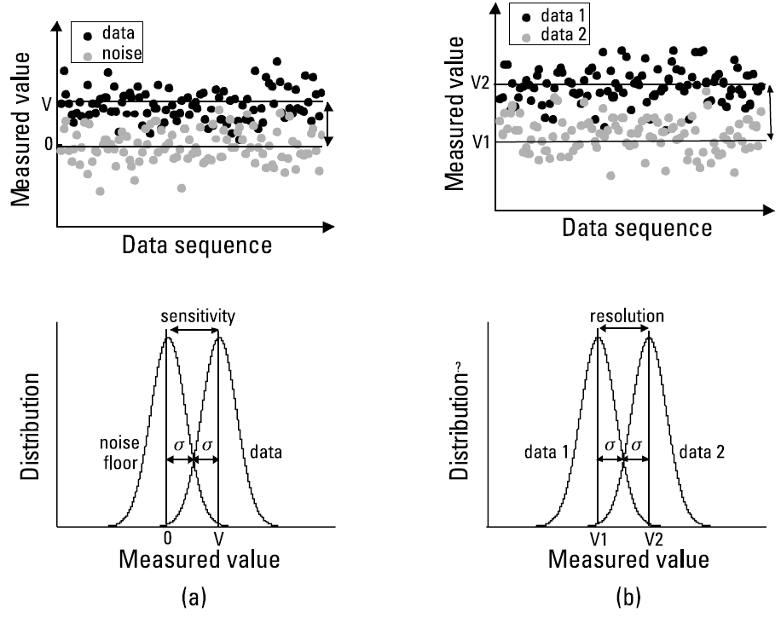
1. Performance Parameters: Sensitivity, Resolution, Precision, Accuracy, Dynamic Range, and SNR
Type A uncertainty: Random uncertainties
➔ averaging
Type B uncertainty: Systematic uncertainties
➔ cannot be analyzed with statistics
Sensitivity: The minimum measurable value
Resolution: The minimum measurable difference between two value
Precision: The numerical value of measurement reproducibility
Ratcliffe, C., and Ratcliffe, B., Doubt-Free Uncertainty In Measurement: An Introduction for Engineers and Students, Cham: Springer, 2015.

Slide 5
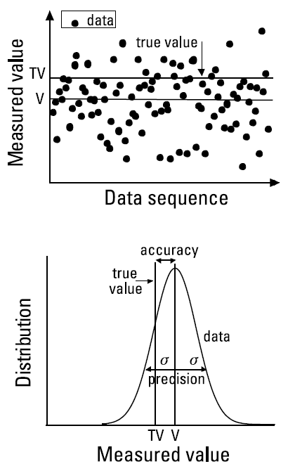
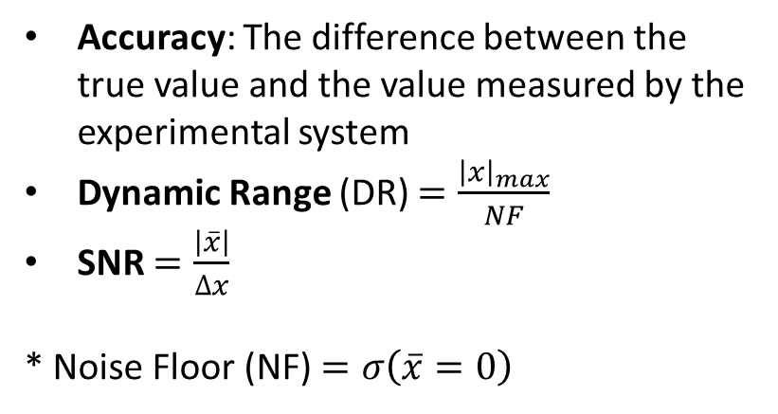
1. Performance Parameters: Sensitivity, Resolution, Precision, Accuracy, Dynamic Range, and SNR
Accuracy: The difference between the true value and the value measured by the experimental system
Dynamic Range (DR) $=\frac{{\left|x\right|}_{max}}{NF}$
SNR $=\frac{\left|\overline{x}\right|}{∆x}$
* Noise Floor (NF) $=σ\left(\overline{x}=0\right)$

Slide 6
DR and SNR of Terahertz TDS

Slide 7
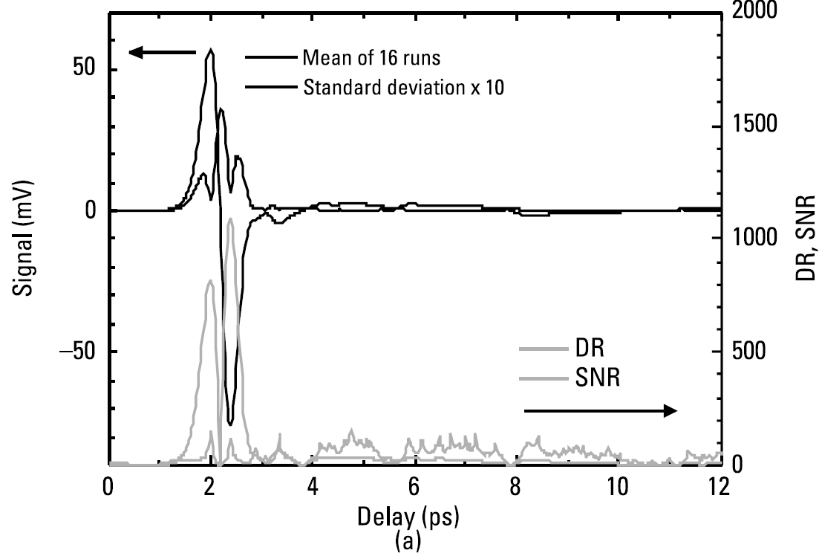
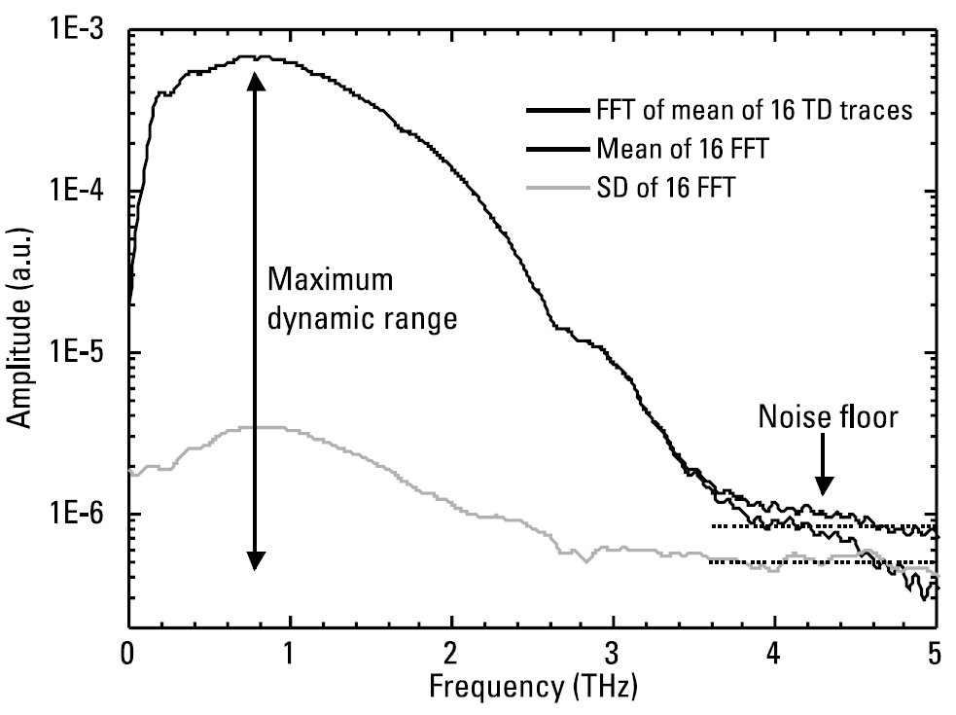
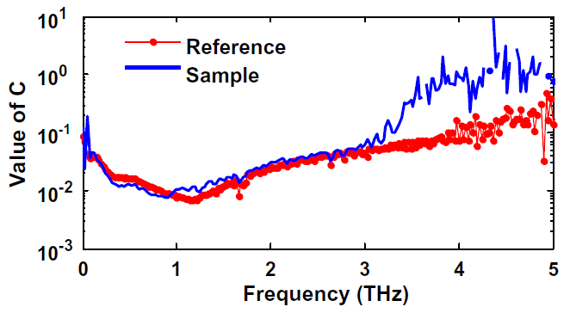

2. DR and SNR of Terahertz TDS
SNR and DR in time-domain
SNR fluctuate strongly and irregularly
No meaningful information
DR follow the absolute value of the signal
$$σ\left(ν\right)=C\left[E\left(ν\right)−h\right]+h$$
Tripathi, S. R., et al., “Pratical Method to Estimate the Standard Deviation in Absorption Coefficients Measured with THz Time-Domain Spectroscopy,” Opt. Commun., Vol. 283, 2010.

Slide 8
System Performance Limits
Due to DR and SNR

Slide 9
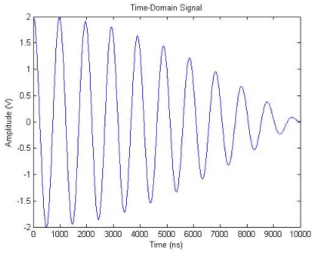
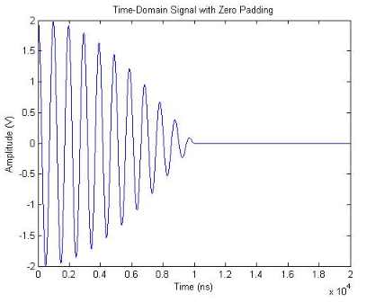
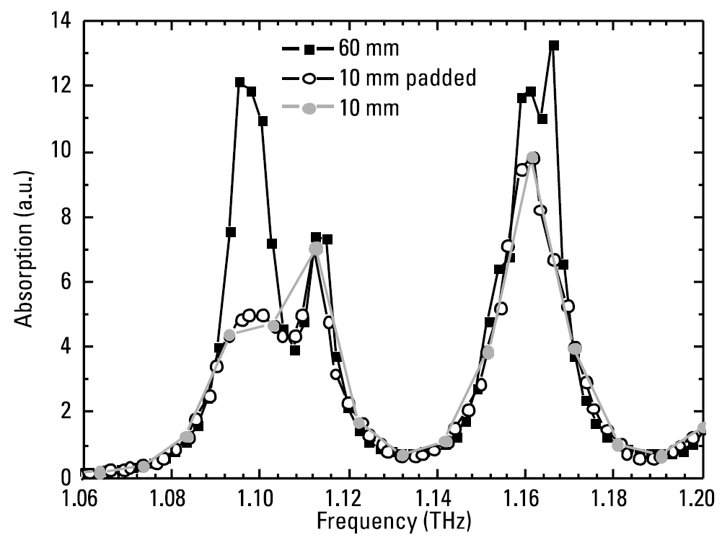
3.1 Frequency Resolution
Zeor-padding
The frequency resolution of a time-domain spectroscopy may be improved by zero-padding. However the additional data points arising from a string of zeros carry no additional information
Hilbert, S. (n.d.). FFT Zero Padding. Retrieved March 15, 2018, from http://www.bitweenie.com/listings/fft-zero-padding/

Slide 10
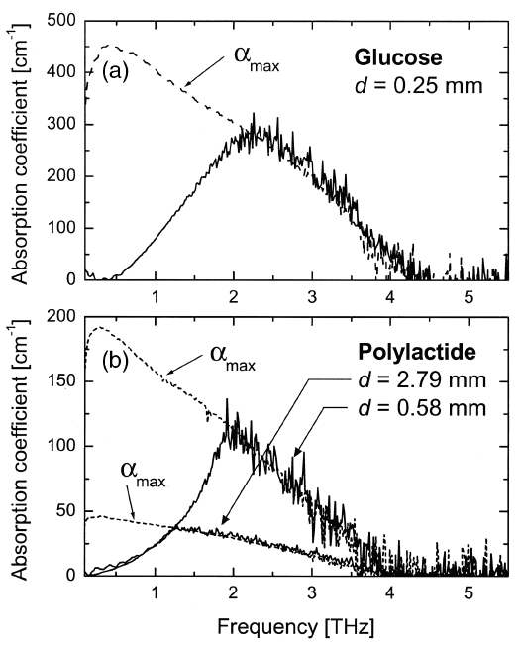
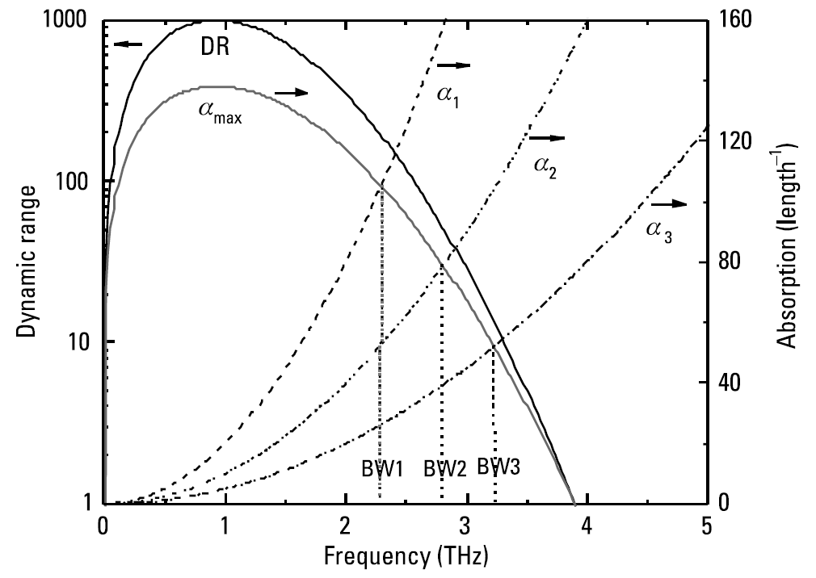
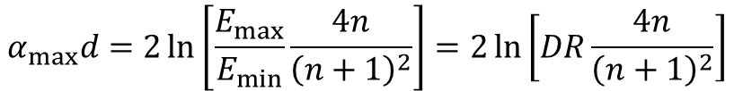
3.2 Meqsurement Bandwidth
In the frequency domain, the dynamic range places limits on the bandwidth, maximum measurable absorption, and usable sample thickness.
$$α_{max}d=2\ln\left[\frac{E_{max}}{E_{min}}\frac{4n}{{\left(n+1\right)}^{2}}\right]=2\ln\left[DR\frac{4n}{{\left(n+1\right)}^{2}}\right]$$
Jepsen, P. U., and B. M. Fischer, “Dynamic Range in Terahertz Time-Domain Transmission and Reflection Spectroscopy,” Opt. Lett., Vol. 30, 2005.

Slide 11
Sources of Random Noise

Slide 12
4.1 Amplitude
Zeor-padding
The frequency resolution of a time-domain spectroscopy may be improved by zero-padding. However the additional data points arising from a string of zeros carry no additional information
Hilbert, S. (n.d.). FFT Zero Padding. Retrieved March 15, 2018, from http://www.bitweenie.com/listings/fft-zero-padding/

Slide 13
4.2 Phase
Zeor-padding
The frequency resolution of a time-domain spectroscopy may be improved by zero-padding. However the additional data points arising from a string of zeros carry no additional information
Hilbert, S. (n.d.). FFT Zero Padding. Retrieved March 15, 2018, from http://www.bitweenie.com/listings/fft-zero-padding/

Slide 14
Systematic Errors

Slide 15
5.1 Alignment Errors
Zeor-padding
The frequency resolution of a time-domain spectroscopy may be improved by zero-padding. However the additional data points arising from a string of zeros carry no additional information
Hilbert, S. (n.d.). FFT Zero Padding. Retrieved March 15, 2018, from http://www.bitweenie.com/listings/fft-zero-padding/

Slide 16
References
Ratcliffe, C., and Ratcliffe, B., Doubt-Free Uncertainty In Measurement: An Introduction for Engineers and Students, Cham: Springer, 2015, pp. 9-18.
Tripathi, S. R., et al., “Pratical Method to Estimate the Standard Deviation in Absorption Coefficients Measured with THz Time-Domain Spectroscopy,” Opt. Commun., Vol. 283, 2010, pp. 2488-2491.
Hilbert, S. (n.d.). FFT Zero Padding. Retrieved March 15, 2018, from http://www.bitweenie.com/listings/fft-zero-padding/
Jepsen, P. U., and B. M. Fischer, “Dynamic Range in Terahertz Time-Domain Transmission and Reflection Spectroscopy,” Opt. Lett., Vol. 30, 2005, pp. 29-31.

